Slide 1

HIV Testing Strategy: The Malawi Experience
Tobias Masina, Godfrey Mwankenja, David Mwalilino
Fred Fredrick Bangara

Slide 2
Outline
Introduction & Background
Malawi Algorithm selection criteria
HIV status verification prior to ART initiation
Commodity supply chain
Measures to ensure adherence to testing strategy
Lessons learnt

Slide 3
Introduction & Background
a. Malawi has committed to achieving the UNAIDS 95:95:95 targets
Currently at 95:98:95
b. 3 test algorithm Pilot was done in 2021 from March to July
9 facilities spread across all regions were targeted
c. 3 test algorithm was adopted in 2022 based on WHO guidance
Phased Implementation underway - currently in 602 out of 800 (75%) facilities
Remaining facilities to be activated by September 2024.

Slide 4
Why a 3-test diagnostic algorithm?
Declining positivity among people tested
91% of all PLHIV have been diagnosed
86% of all PLHIV are on ART
Fewer remaining undiagnosed PLHIV “hidden” in a large population
We are looking for this narrow yellow slice

Slide 5

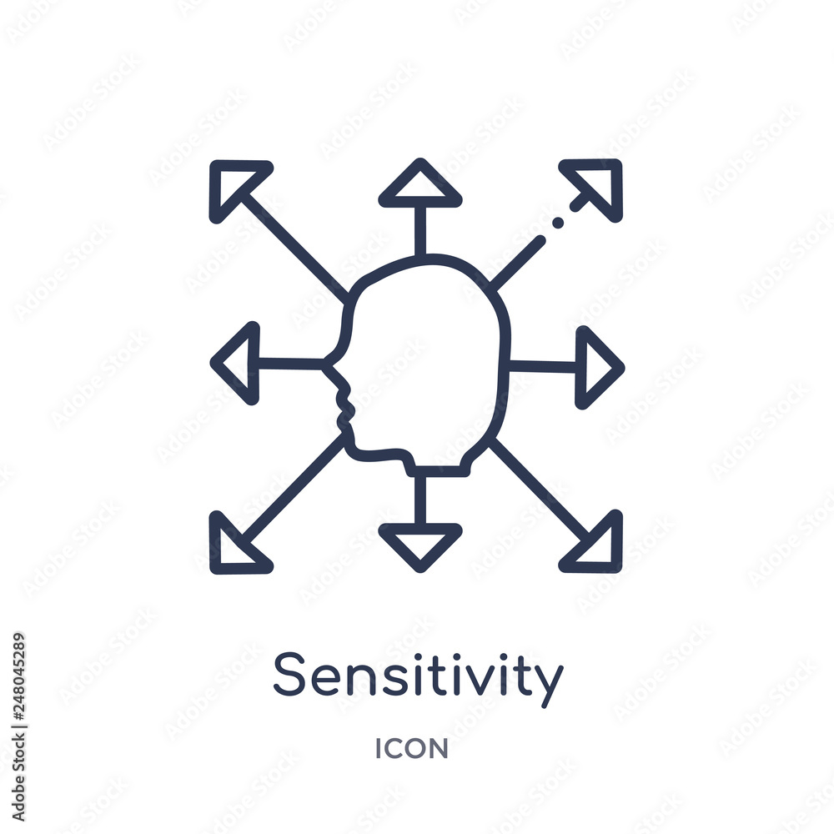

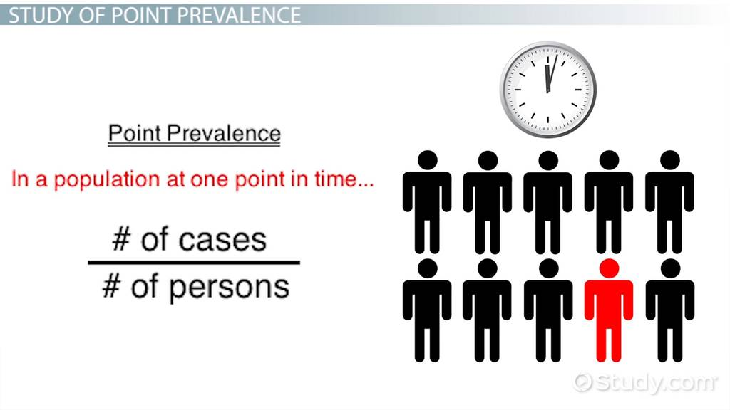
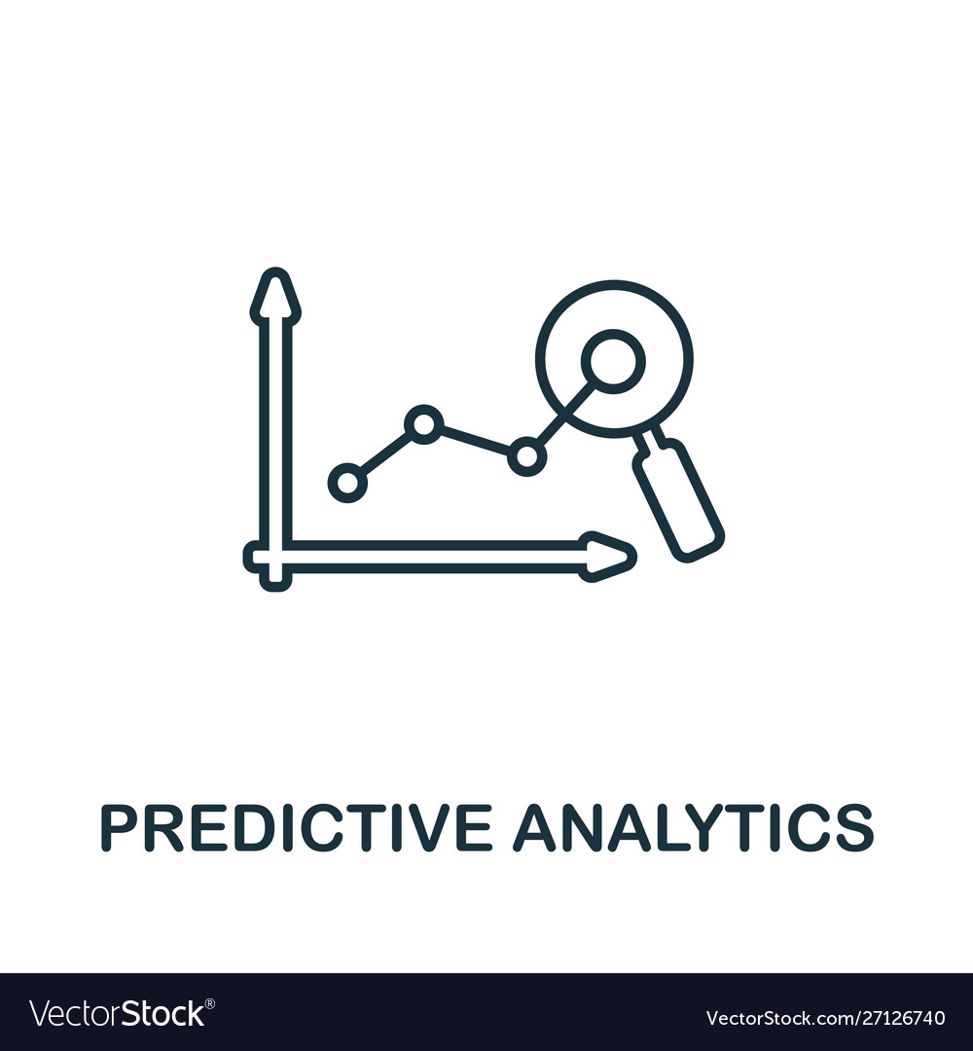
Criteria for HIV testing strategy selection
Objective (diagnosis, surveillance, blood safety, or research)
Sensitivity and specificity of the test(s)
3. HIV prevalence in the population being tested
Positive Predictive Value (PPV)

Slide 6
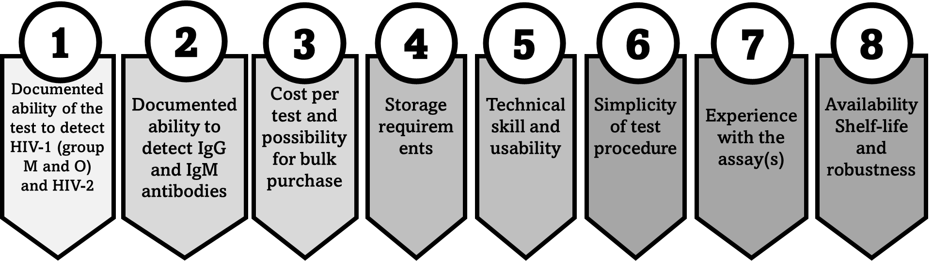
Criteria for Test Kit Selection (WHO)

Slide 7
Full testing algorithm and flow charts

Slide 8
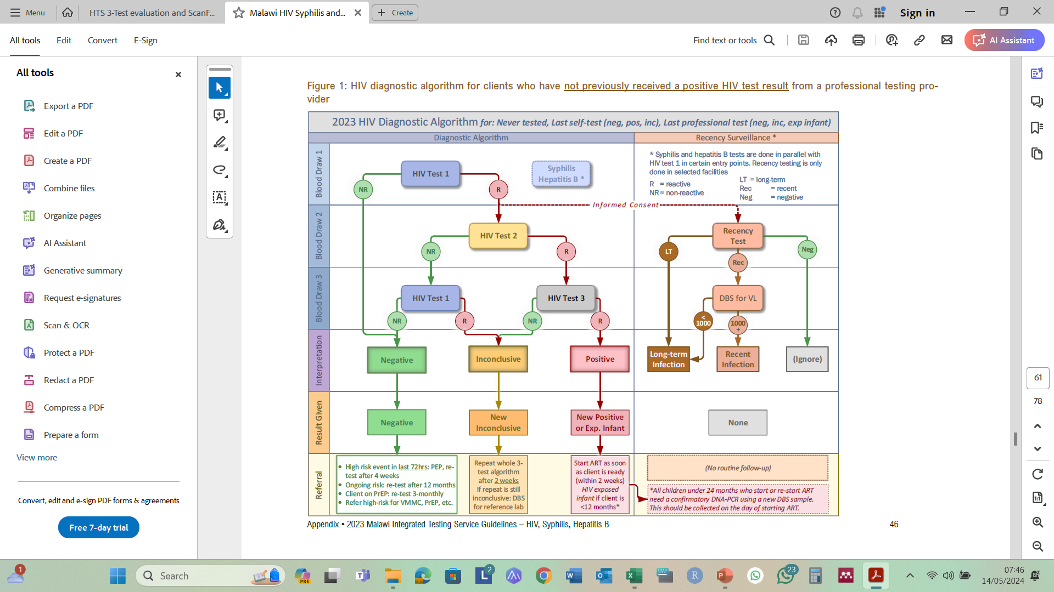

Slide 9
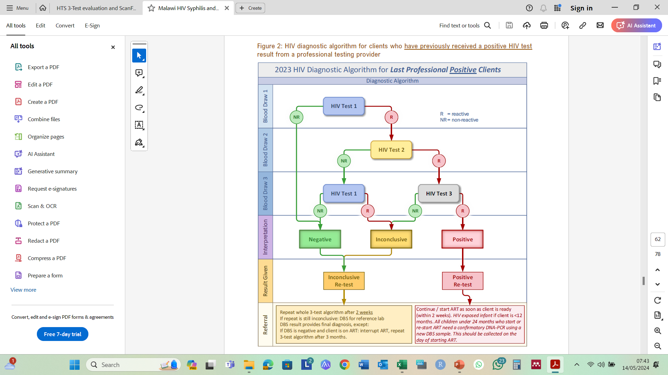
Currently no alternative Algorithm in HIV testing

Slide 10
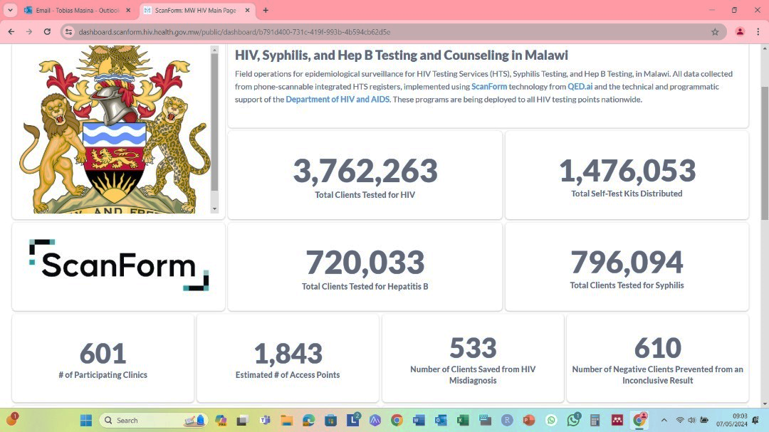
Data Summary on the Dashboard
99.96% correct adherence to 3-test algorithm
Notes:
Lessons
99.96 % to 3 test Algorithm
533 Client prevented from ART initiation with test 1 and 2 concordance positive
610 Clients prevented from repeat testing.

Slide 11
HIV status verification prior to ART

Slide 12


Testing commodities supply chain Supply chain
Commodity distribution is done very 2 months
Maximum stock status of 4 months
Facilities are expected to keep commodities to cover 2 months period
Availability of toll-free numbers to assist facilities with less than 2 months supply of commodities
Relocation of commodities to site with less stock

Slide 13




Measures to ensure adherence to testing strategy
Supportive Supervision and mentorship
RT-CQI special audits
Data Quality Audit (DQA) from Scanform dashboard alert

Slide 14
Lessons Learnt

Slide 15
Increase in confirmatory inconclusive
Launch of HIV 3 Test Algorithm
Notes:
Increase in confirmatory Inconclusive could be because of those who tested previously in 2 test Algorithm now being tested with 3 test algorithm.
After launching 3 test algorithm there is an increase in confirmatory inconclusive.
Denominator is last positive data

Slide 16
Reduced non-disaggregated data on HIV positive clients

Slide 17
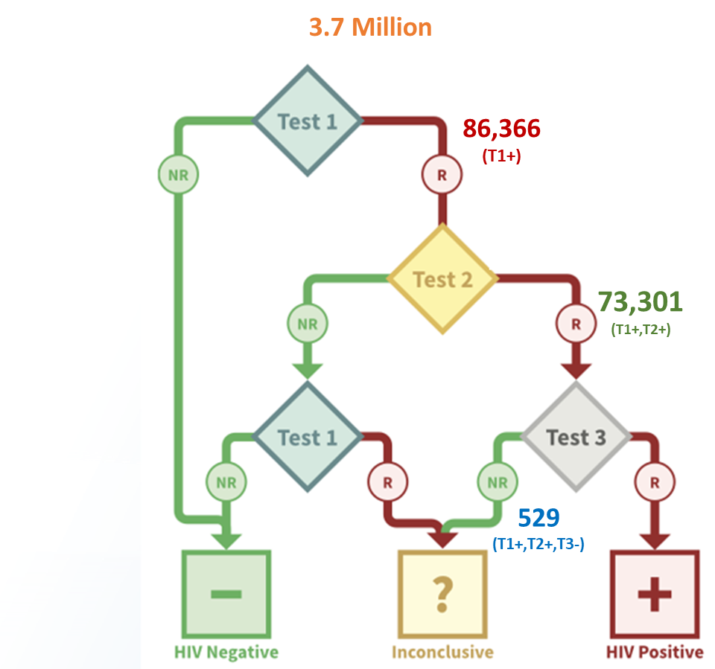
3-Test Algorithm potentially saving misdiagnosis
Nov 2022 to April 2024
529 (0.7%) with (T1+,T2+,T3-) out of 73,301 with (T1+,T2+) marked as “inconclusive”
3-Test Algorithm
Repeat whole 3-test algorithm after 2 weeks If repeat is still inconclusive: DBS for reference lab
2-Test Algorithm
likely been given a false positive result and started on ART on the same day.

Slide 18
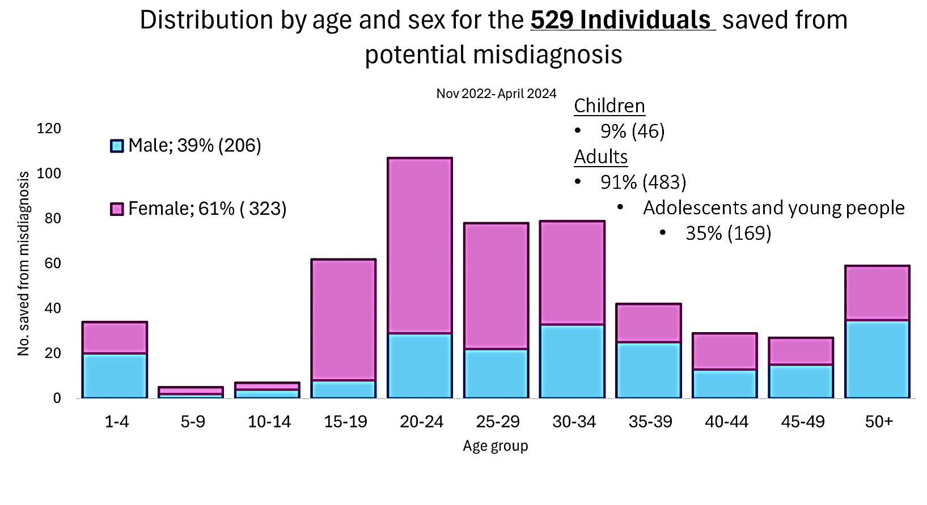
3-Test Algorithm potential saving from misdiagnosis: age & sex distribution
Nov 2022 to April 2024

Slide 19
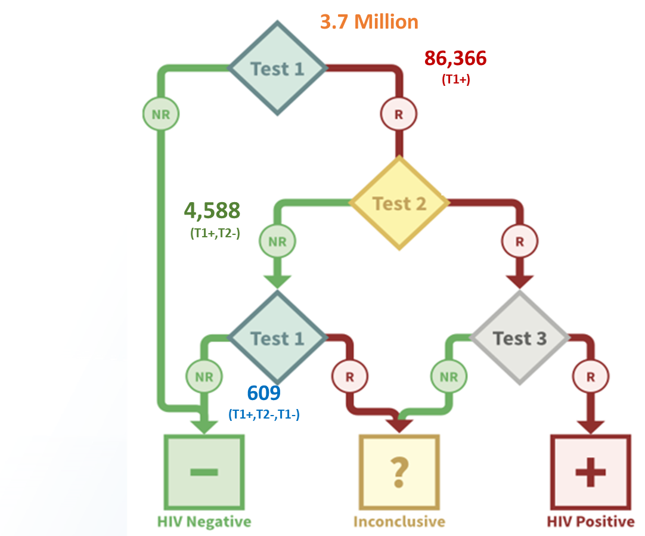
3-Test Algorithm saving from re-testing
Nov 2022 to April 2024
609 (13%) with (T1+,T2-,T1-) out of 4,588 that would have been referred for re-testing were classified as HIV negative with the 3-test algorithm
3-Test Algorithm
Final result: “Negative”
2-Test Algorithm
Final result : “Inconclusive” and Re-test after two weeks

Slide 20
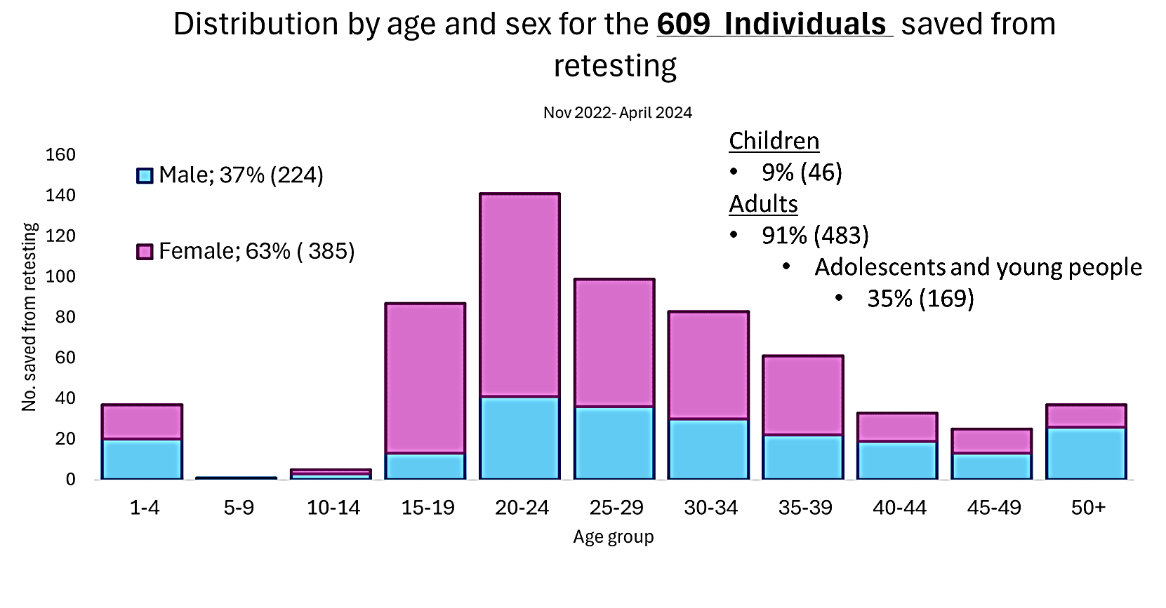
3-test Algorithm saving from re-testing: age & sex distribution
Nov 2022 to April 2024

Slide 21
Thank You

